Slide 1

U.S. Social Security Insolvency Crisis
11.4.24 Project Update
Davis R, Elliot S, Daniel L, Isabella G, Stella Z, Ben B

Slide 2
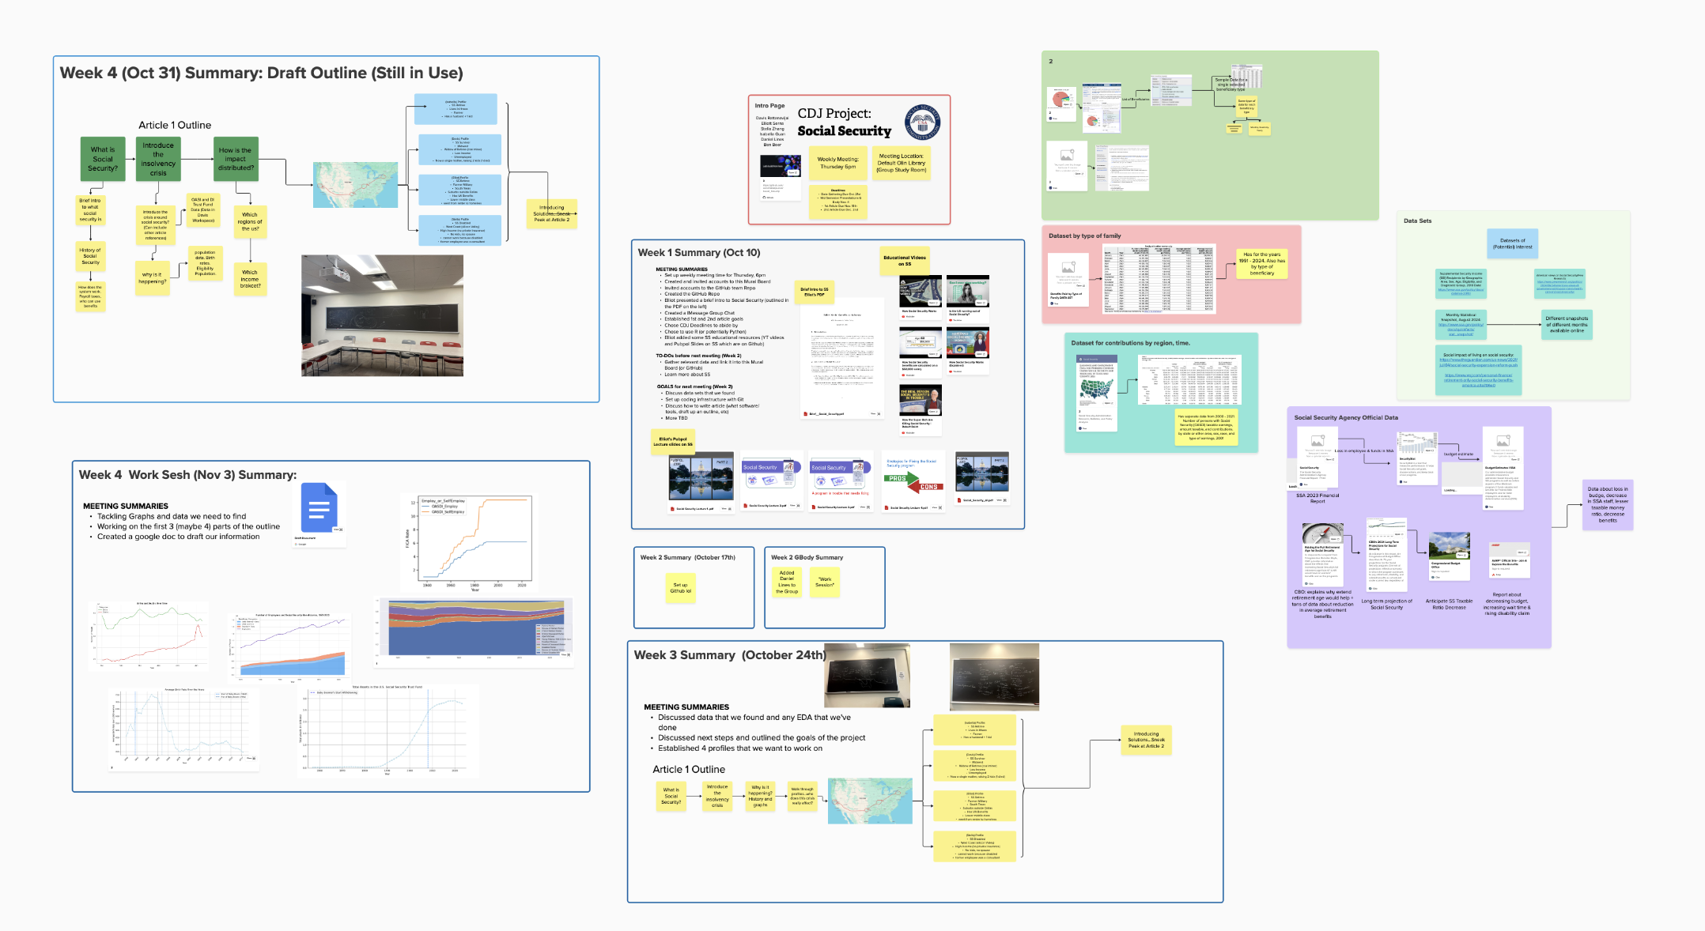

Progress: Brainstorm

Slide 3
Progress: Project Outline
What is Social Security?
What is the SS insolvency Crisis?
Trust Fund Depletion
Profile Case Study of 4 Americans
What does SS achieve?
How does it work monetarily?
Brief History of SS
When is SS estimated to run out of money?
Why is this happening?
Which regions of the USA?
Who is most at risk?
Which income brackets?
Which generation will bear the most burden?
Ithaca Farmer Retiree
Widow of Coal Miner
Homeless Texas Veteran 🇺🇸
Disabled Childless Silicon Valley Engineer
How do we solve the crisis?
Introduce the 5 potential solutions
Trump vs Harris Solutions
Sneak Peak to Article 2

Slide 4
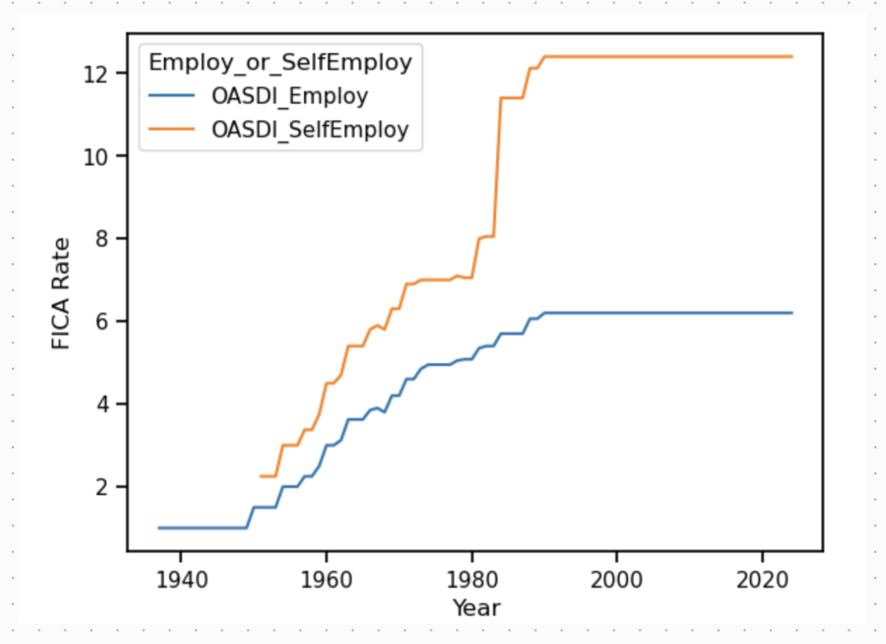
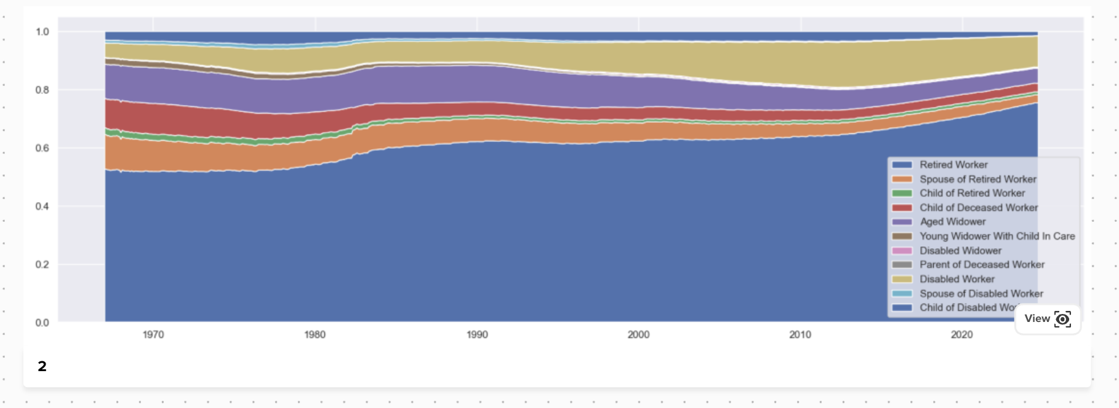
Progress: 1. What is Social Security?
What does SS achieve?
Provide financial protection to ALL American throughout their whole life (VERY BIPARTISAN)
How does it work?
OASI vs DI Types of Beneficiaries
Mandatory FICA Taxes
SS Benefits from AIME (not the math competition lol)
History of Social Security
Previous Insolvency Crises
1983 they raised retirement age…
Raising payroll tax

Slide 5
Progress: Project Outline
What is Social Security?
What is the SS insolvency Crisis?
Trust Fund Depletion
Profile Case Study of 4 Americans
What does SS achieve?
How does it work monetarily?
Brief History of SS
When is SS estimated to run out of money?
Why is this happening?
Which regions of the USA?
Who is most at risk?
Which income brackets?
Which generation will bear the most burden?
Ithaca Farmer Retiree
Widow of Coal Miner
Homeless Texas Veteran 🇺🇸
Disabled Childless Silicon Valley Engineer
How do we solve the crisis?
Introduce the 5 potential solutions
Trump vs Harris Solutions
Sneak Peak to Article 2

